Slide 1

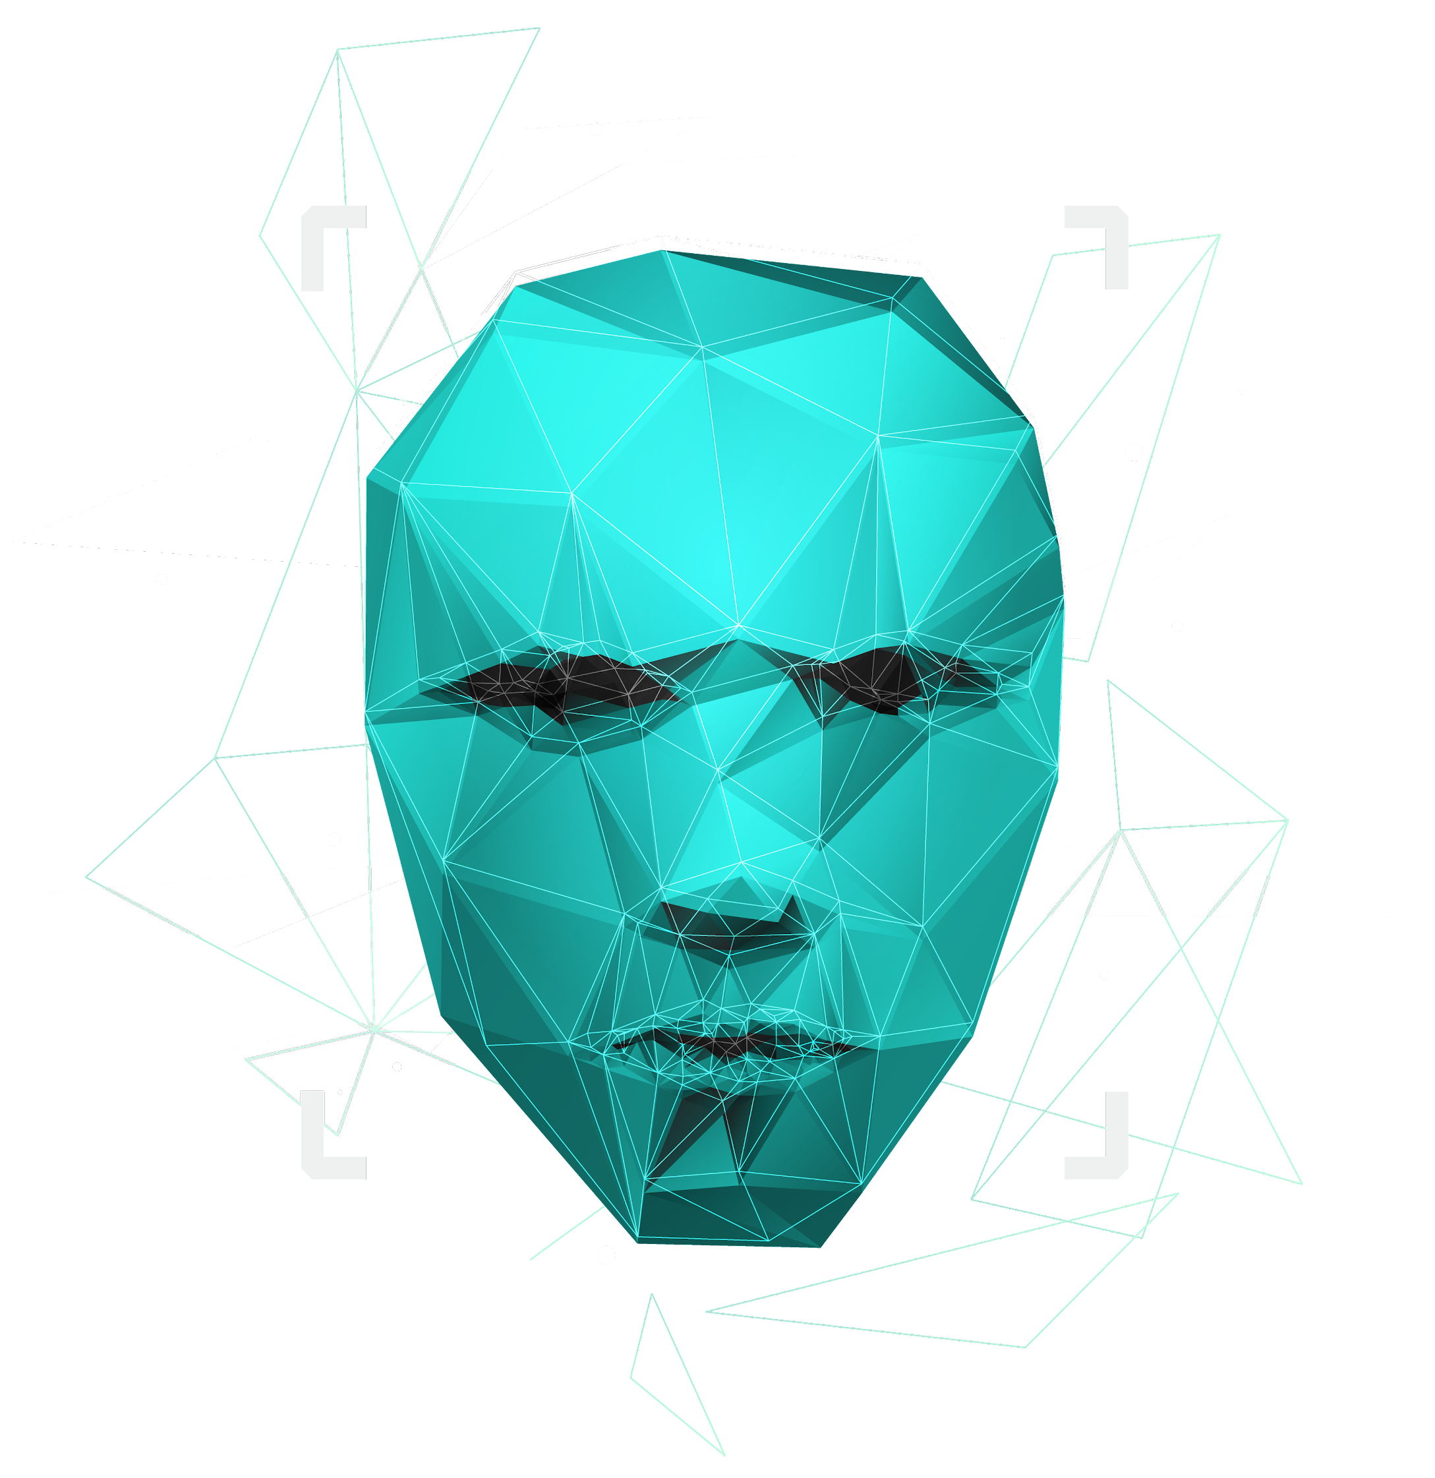
Jarvis using python
Uzair Khan
Waqar
Farhan
Ali Hassan

Slide 2

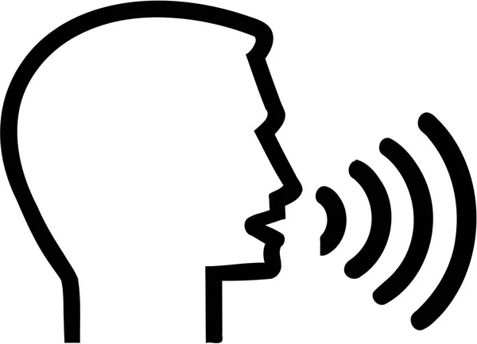




Steps involved in conversion
Speech
Text
Folder
Google
YouTube

Slide 3

Benefits of using JARVIS ● Easy to use ● Speech to text ● Can work with variety of commands ●Its Helpful for disable the people how do no see ● Custom commands ● secure ● Security purpose ● Artificial intelligence

Slide 4
OUR PROGRESS
Speech recognition
pyjokes
To identify the word in spoken language
Jarvis tell us a joke
pyttsx3
DateTime
Text to speech convertor
Tell us the current time
OS
Create a folder or rename a folder

Slide 5

SOFTWARE DESKTOP
We can use the Jarvis in our Computer to the save time and for Security purpose.

Slide 6

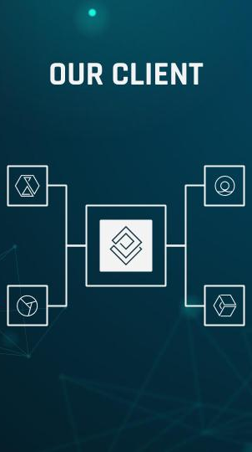
IN Future Goals MOBILE APP
Teach Jarvis to pronounce names.
Save Time
Its help to Disable people
Post to Twitter/Facebook.
Search recent tweets.
Identify, buy songs.
Weather.
Roll dice, flip coins.
Best movies.
Jarvis got personality.

Slide 7
THANKS!
Do you have any questions?
uzairkhanc17@gmail.com
+92 3015715759
waqaramjad143@gmail.com
+92 3084753245

